Slide 1
Presentation by:
Shekhar Anand
EDA Case Study on Bank Loan

Slide 2
Business Objectives
The company wants to understand the driving factors behind loan default, i.e. the variables which are strong indicators of default. The company can utilize this knowledge for its portfolio and risk assessment.
Develop a basic understanding of risk analytics in banking and financial services and understand how data is used to minimize the risk of losing money while lending to customers.

Slide 3
Problem Statement
Identify patterns and relationship which indicate if a client has difficulty paying their instalments which may be used for taking actions such as denying the loan, reducing the amount of loan, lending (to risky applicants) at a higher interest rate, etc.
This will ensure that the consumers capable of repaying the loan are not rejected. Identification of such applicants using different EDA approach.

Slide 4
Methodology
Load the dataset
Identify the percentage of missing Data in the dataset and remove the values which is greater than 35%.
Impute the Null values
Dealing with Target Variable
Identify Outliers in the Dataset: Detect and identify outliers in the dataset
Data Cleaning
Perform Univariate, Bivariate and Multi-Variate Analysis on the both Dataset Application and Previous Application.
Do merging of current and previous application data set and do the analysis.

Slide 5
Detail of outliers in application data
There are few columns where the outlier values are standing out from the rest of the values.
Few columns were having continuous range of values above the upper fence by plotting the graph using boxplot.
List of Outliers – 'CNT_CHILDREN', 'AMT_INCOME_TOTAL', 'AMT_CREDIT', 'AMT_ANNUITY', 'AMT_GOODS_PRICE', 'DAYS_BIRTH', 'DAYS_EMPLOYED', 'DAYS_REGISTRATION'
We are not deleting the outlier data points due to the importance of data while doing analysis.

Slide 6
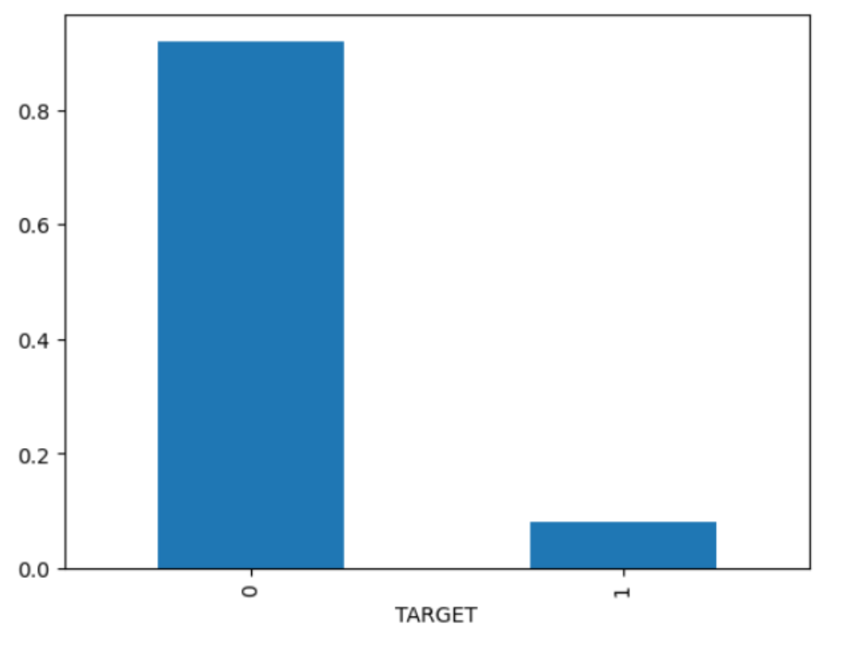
TARGET Column
Ratio of Target column 0 and 1 is 11.38
0 – NO - 2,82,686
1 – Yes - 24,825
1 in every 11 applicant has payment difficulty

Slide 7
UNIVARITAE ANALYSIS ON APPLICATION DATASET

Slide 8
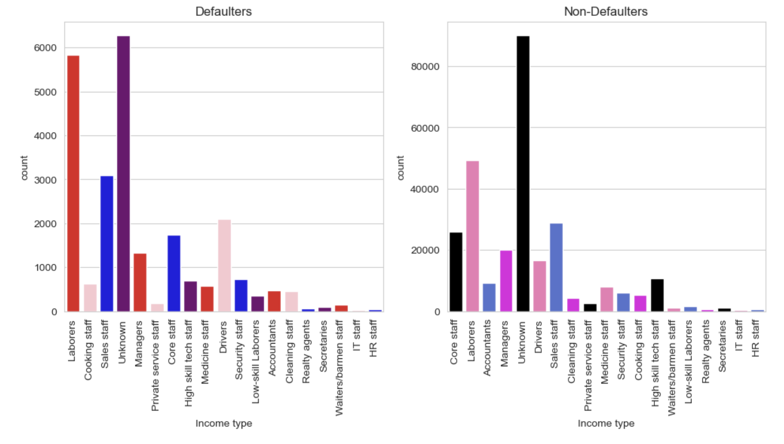
Analysis of occupation type
Unknown is more in both Defaulter(1) and non-defaulter(0)
Laborers is 2nd more Defaulter(1) and non-defaulter(0)

Slide 9
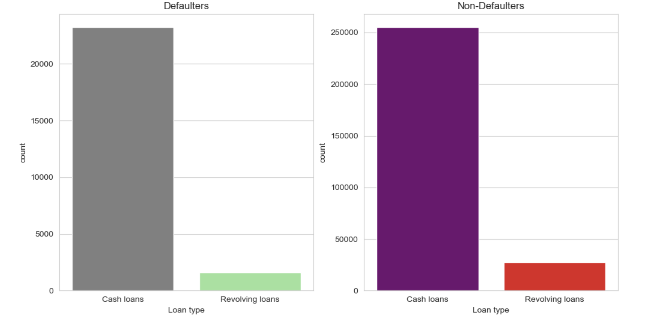
Analysis of LOAN type
Cash Loans is more in both Defaulters(1) and non-defaulters(0)

Slide 10
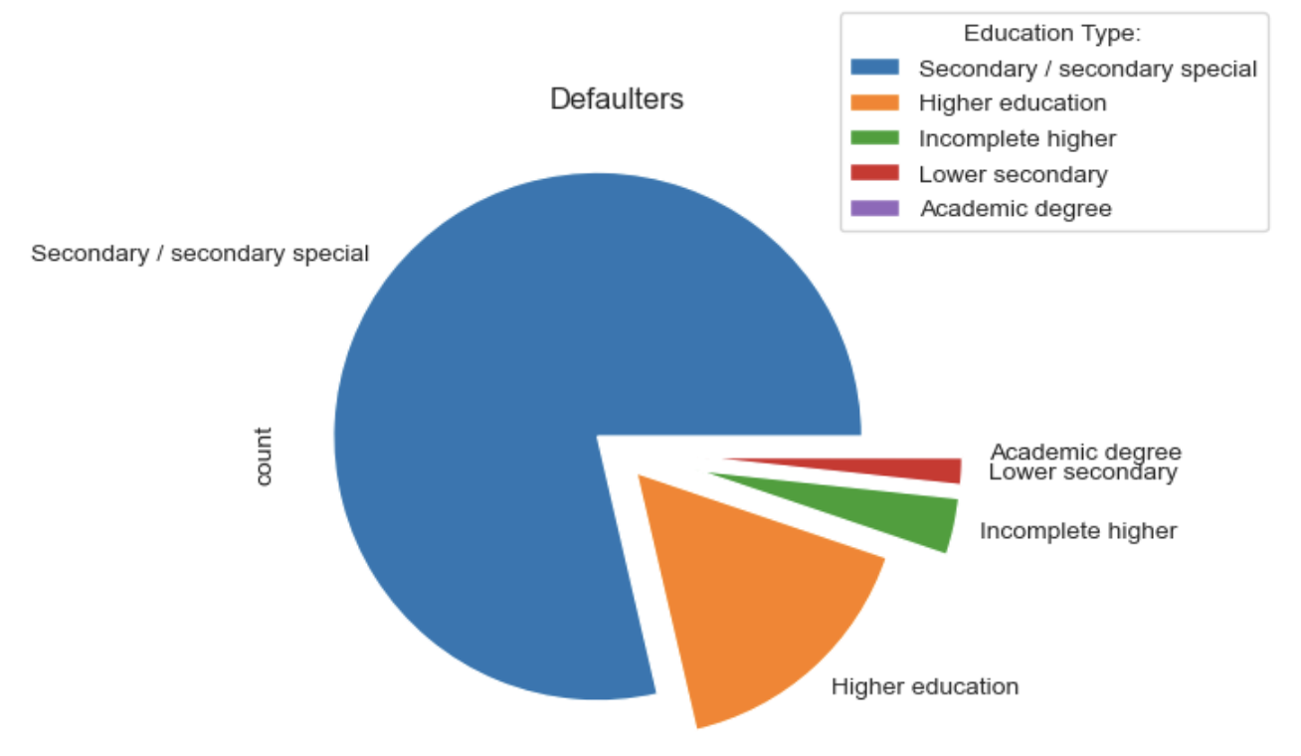
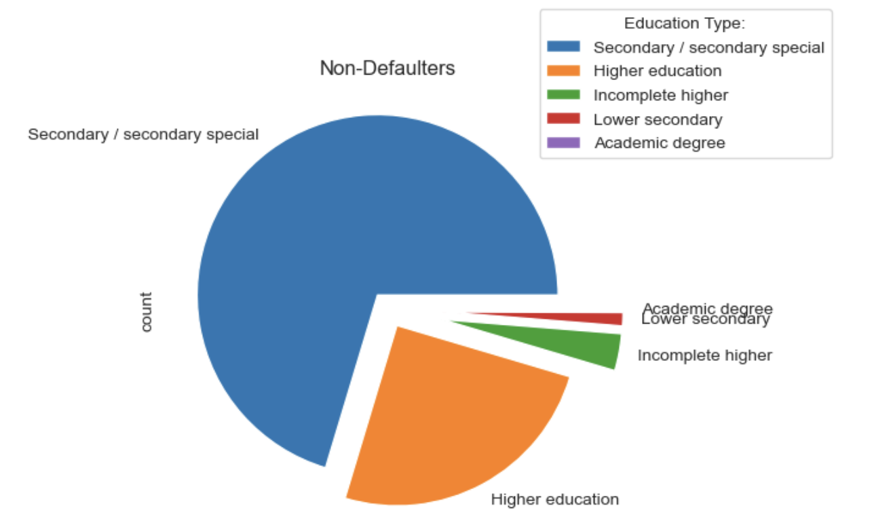
Analysis of education type
Secondary/Secondary special is more in both Defaulter(1) and non-defaulter(0)
Academic degree is less in both Defaulter(1) and non-defaulter(0) so, we can be consider for loans.

Slide 11
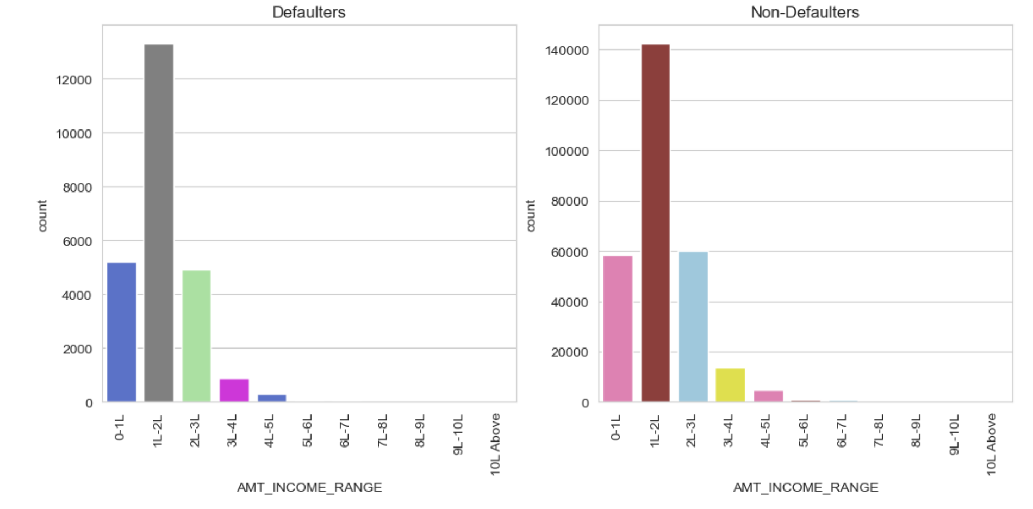
Analysis of Amount INCOME RANGE
1-2L Income range is more in both Defaulter(1) and non-defaulter(0)

Slide 12
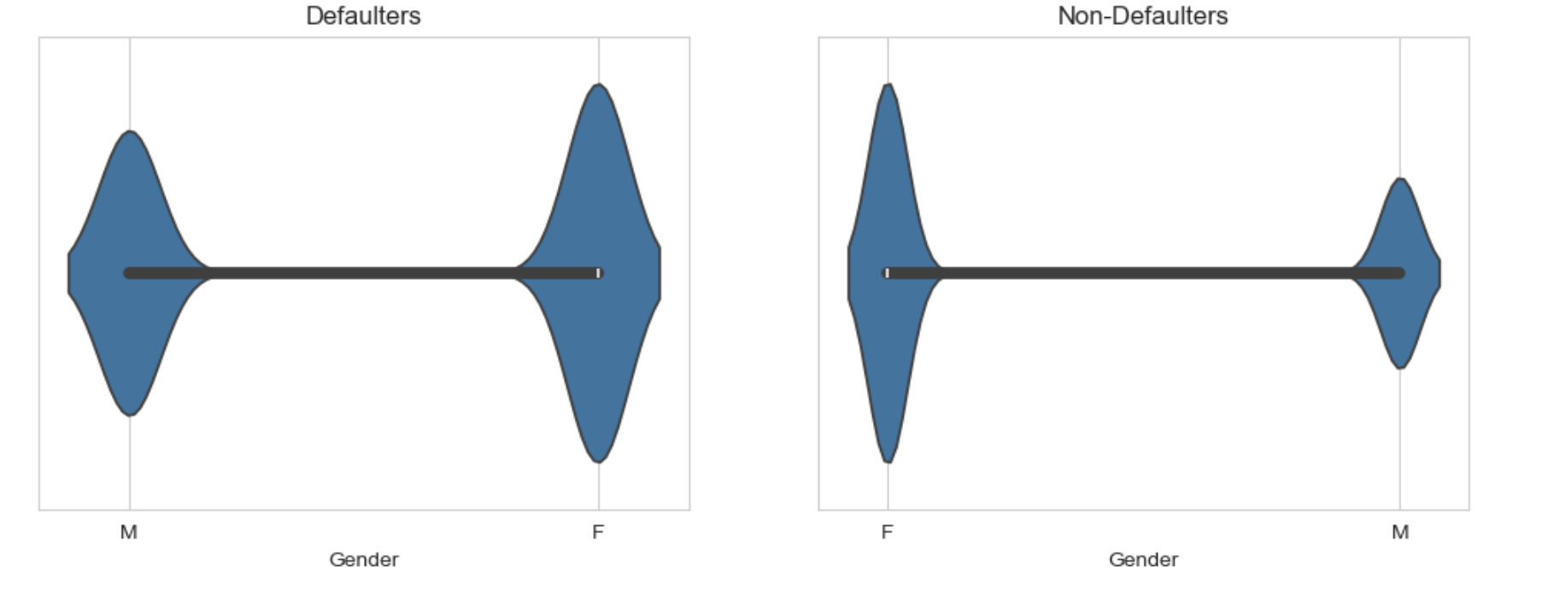
Analysis of Gender
Female applicants are more compared to Male applicants.
Number of female is more in both Defaulter(1) and non-defaulter(0).

Slide 13
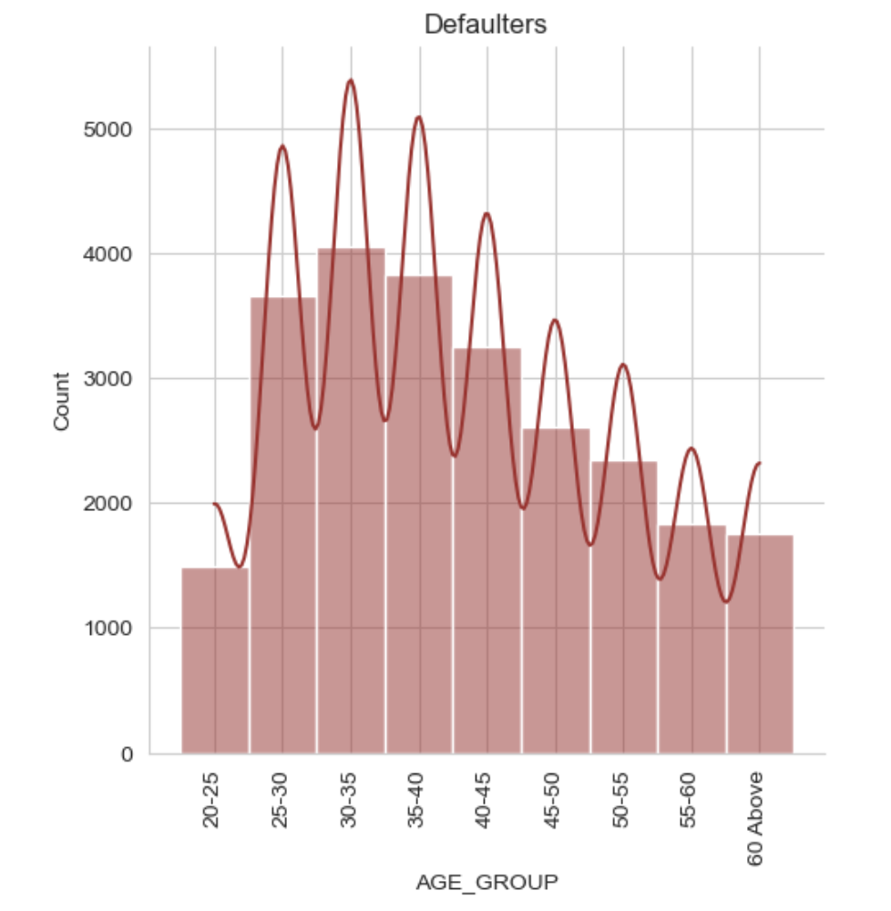
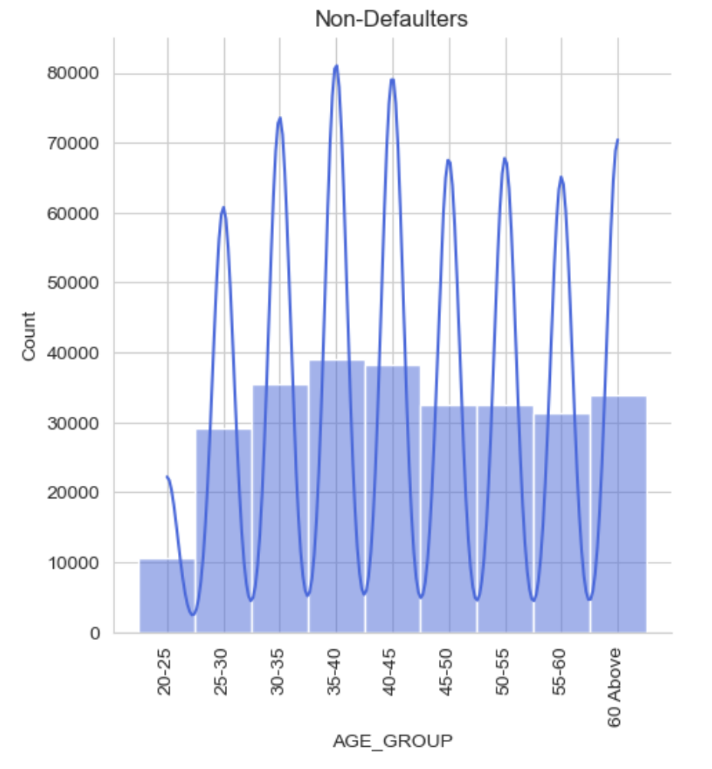
Analysis of AGE group
Group age 30-35 is more defaulters(1)
Group age 35-40 is more non-defaulter(0).

Slide 14
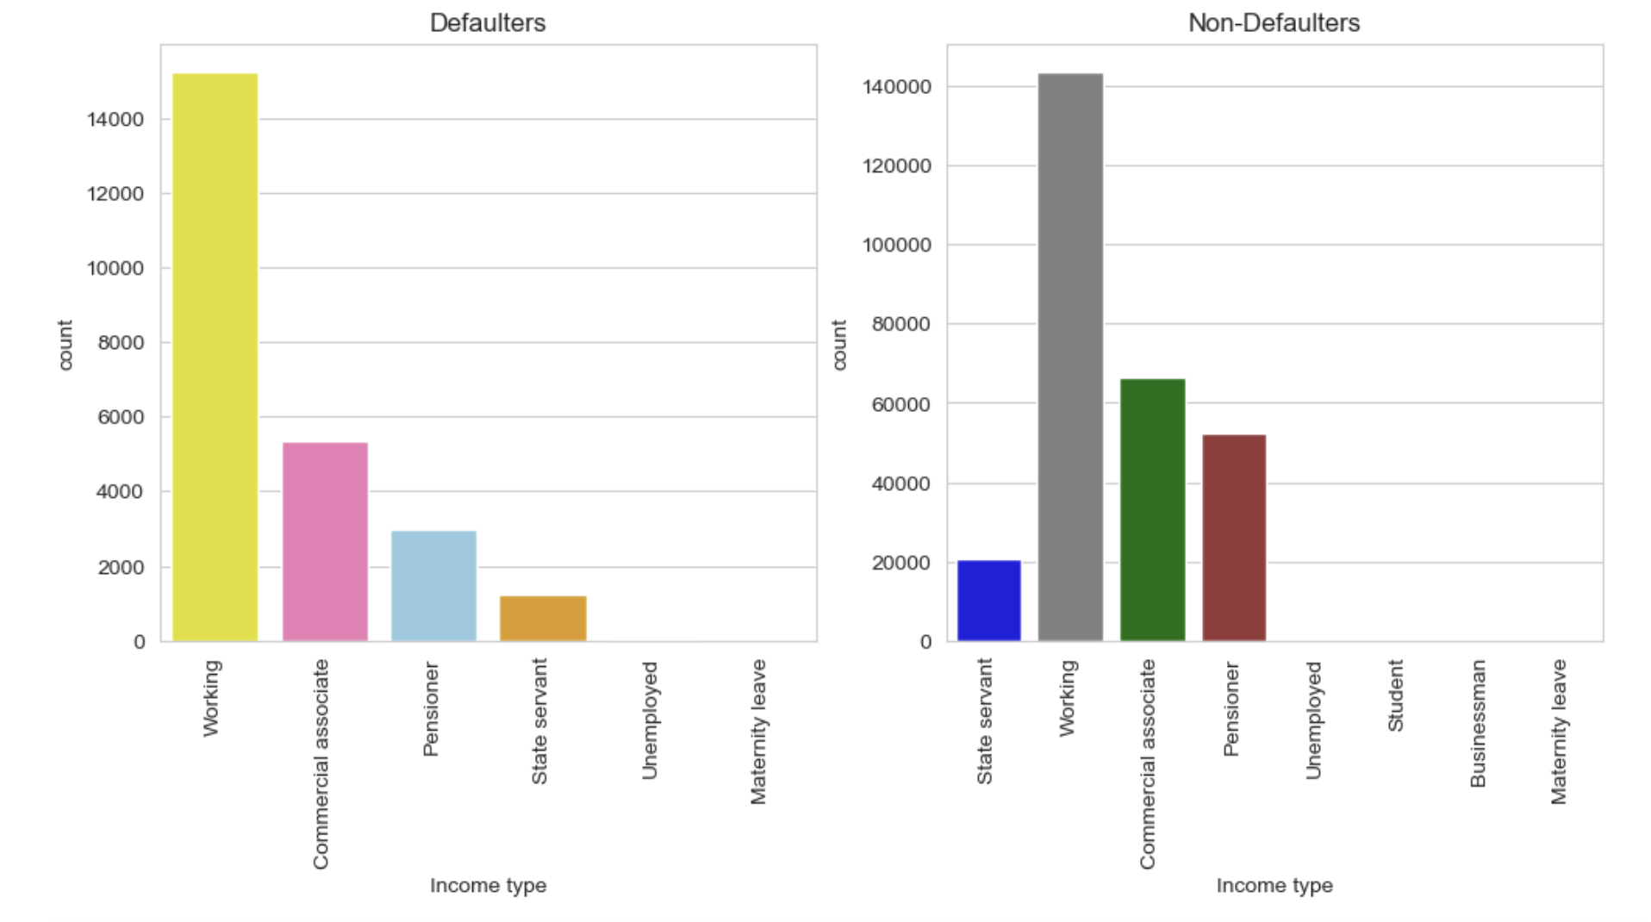
Analysis of Income type
Working Professional people count has more in both Defaulter(1) and non-defaulter(0) in comparison to others.

Slide 15
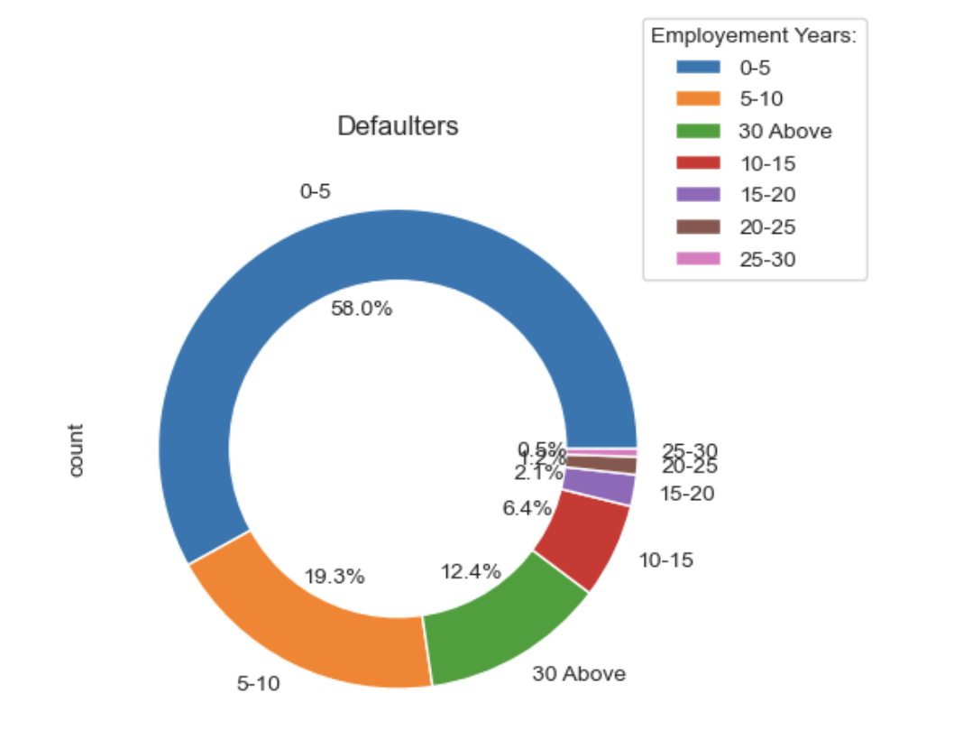
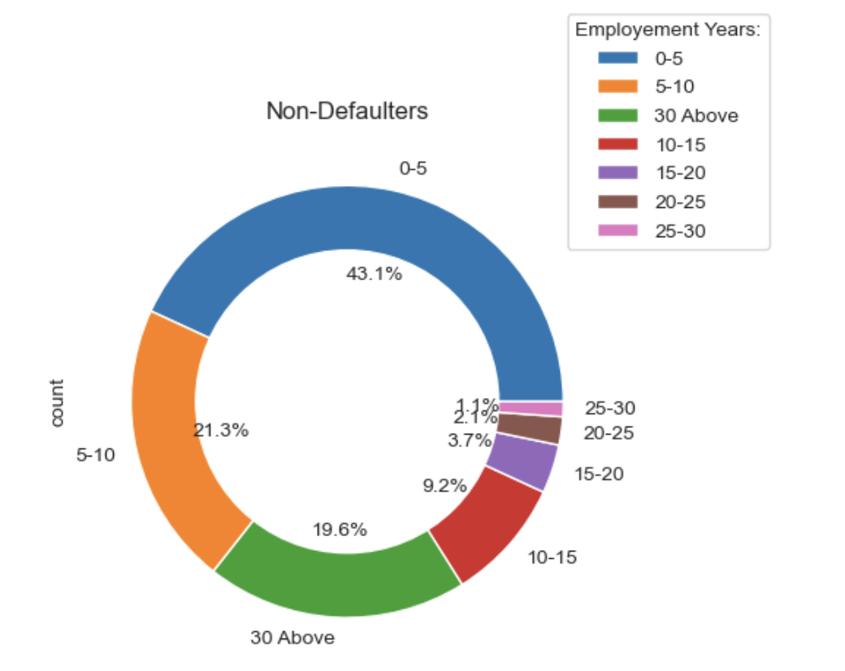
Analysis of employment years
Majority of the Employee is from 0-5 range for both defaulters(1) and non-defaulters(0).
Work experience and loan application are inversely proportional.
As work experience increase loan applicants are decreasing.

Slide 16
Bivariate ANALYSIS ON APPLICATION DATASET

Slide 17
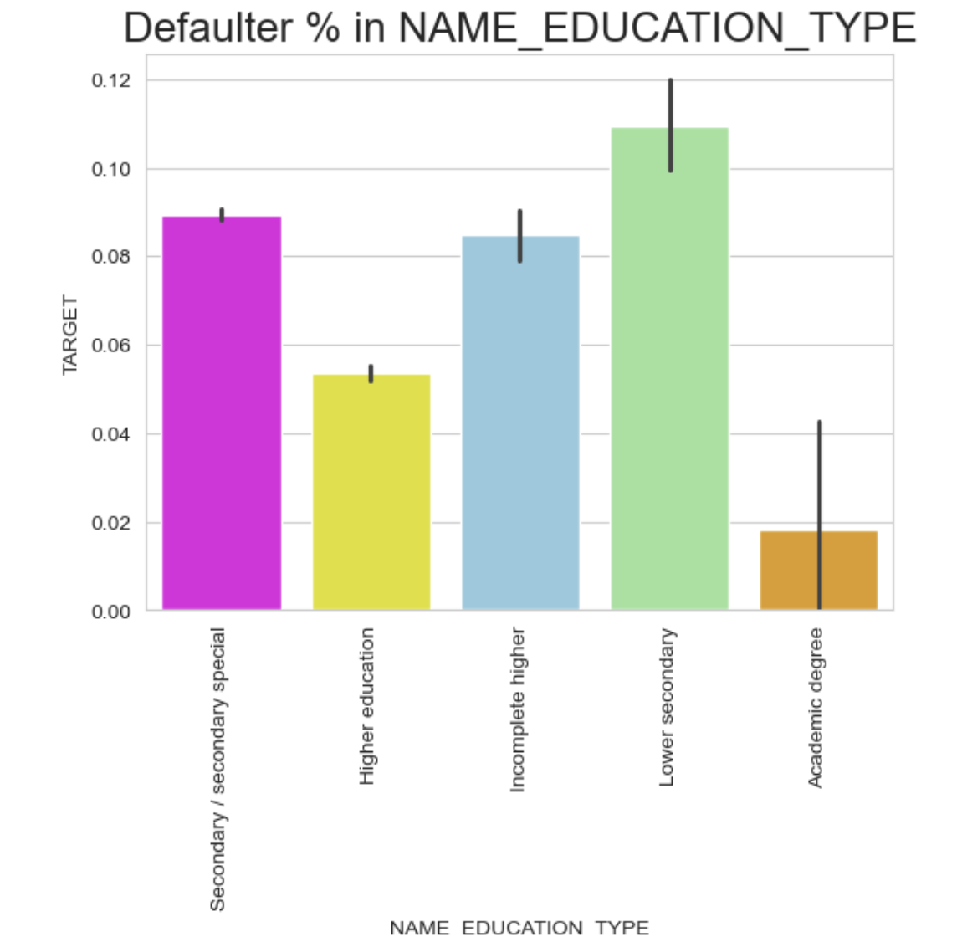
Analysis of education type
Lower secondary is highest percentage of defaulters.
Academic degree is lowest percentage of defaulters. So Academic degree education can consider for loan.

Slide 18
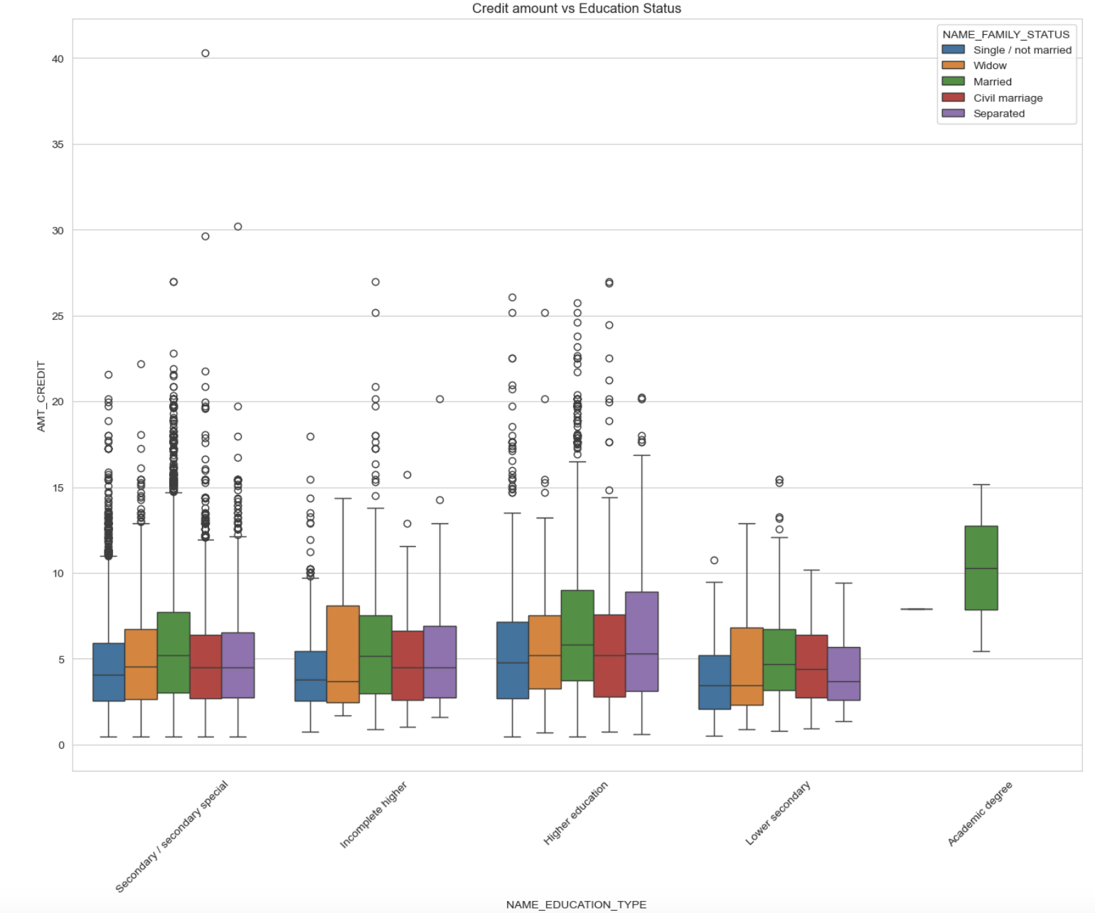
Analysis of education Status and amount credit
Married people with Academic degree is having highest amount credited

Slide 19
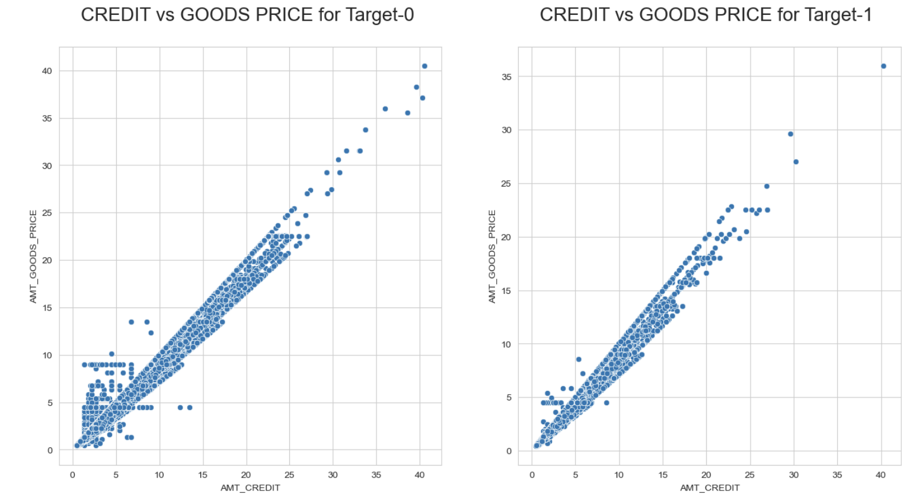
Analysis of amount goods price and amount credit
AMT CREDIT and AMT GOODS PRICE are highly corelated, which means if increase in goods price, the credit increased directly and vice versa.

Slide 20
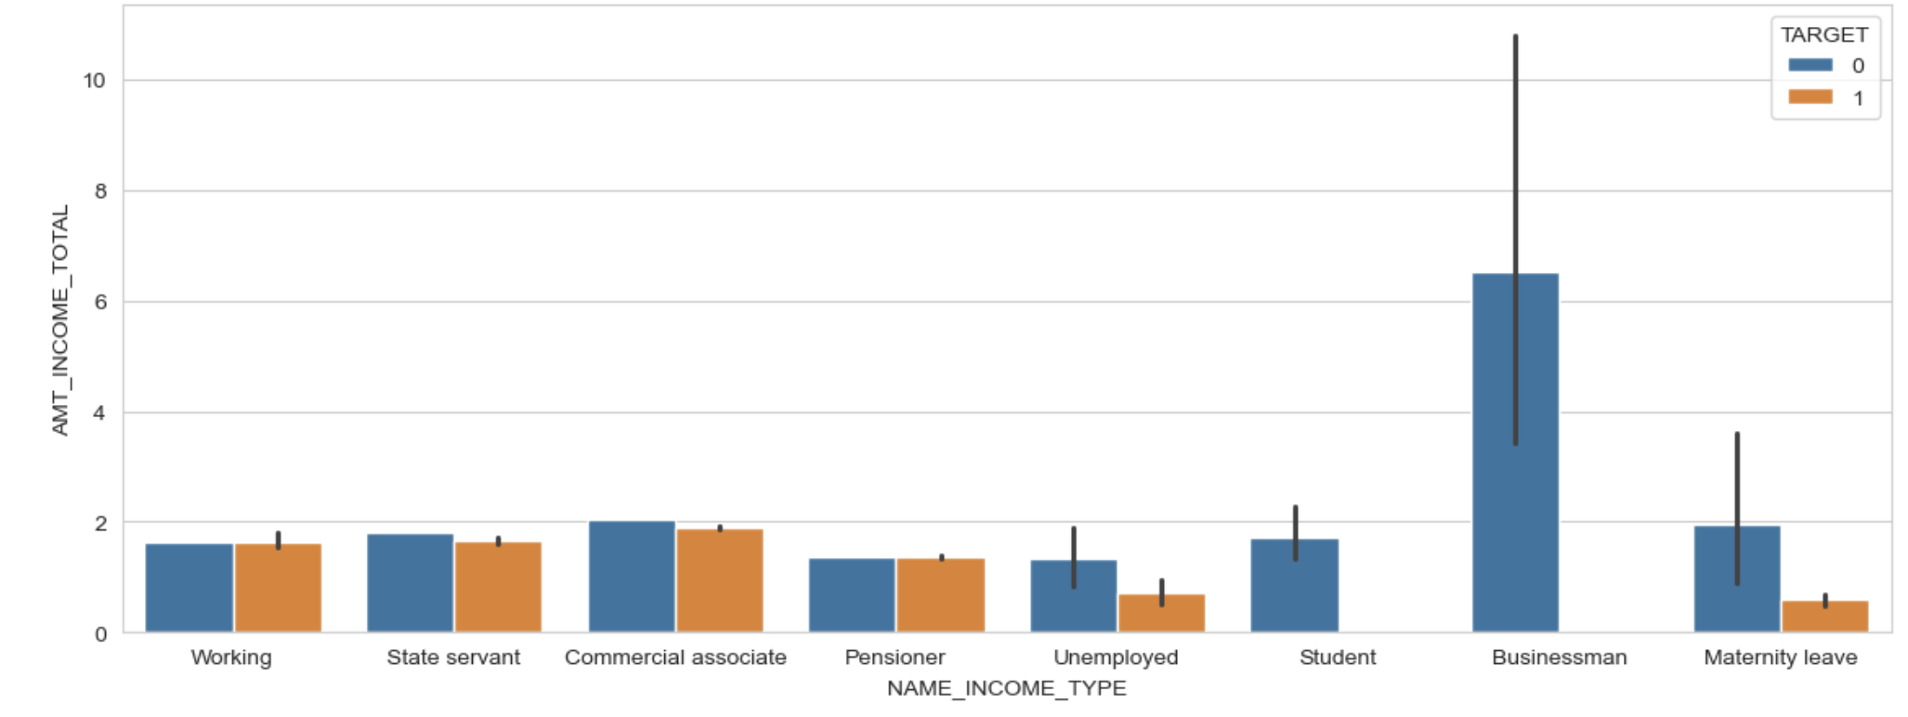
Analysis of name income type and amount income total
No defaulters for Businessman and student having income. Bank can consider them for loan.

Slide 21
Multi-variate ANALYSIS ON APPLICATION DATASET

Slide 22
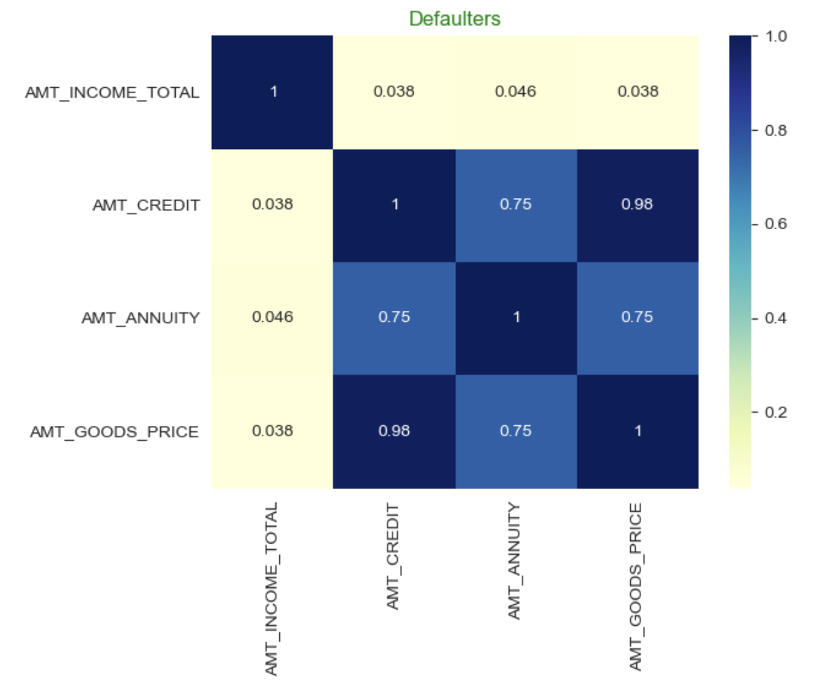
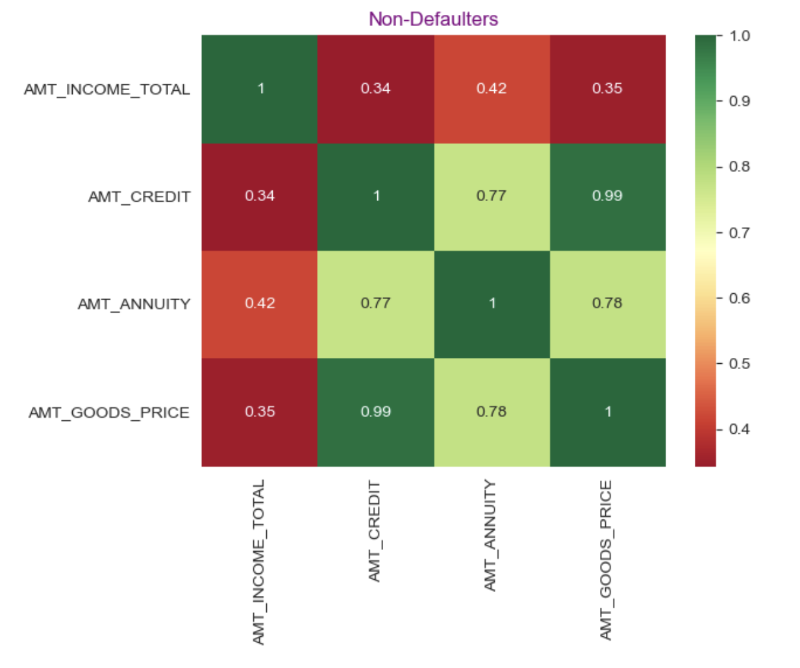
Analysis of AMT_INCOME_TOTAL, AMT_CREDIT, AMT_ANNUITY and AMT_GOODS_PRICE
Highly corelate columns(Defaulter)
- AMT_CREDIT and AMT_ANNUITY (0.75)
- AMT_CREDIT and AMT_GOODS_PRICE (0.98)
- AMT_ANNUITY and AMT_GOODS_PRICE (0.75)
Highly corelate columns(Non-Defaulter)
- AMT_CREDIT and AMT_ANNUITY (0.77)
- AMT_CREDIT and AMT_GOODS_PRICE (0.99)
- AMT_ANNUITY and AMT_GOODS_PRICE (0.78)

Slide 23
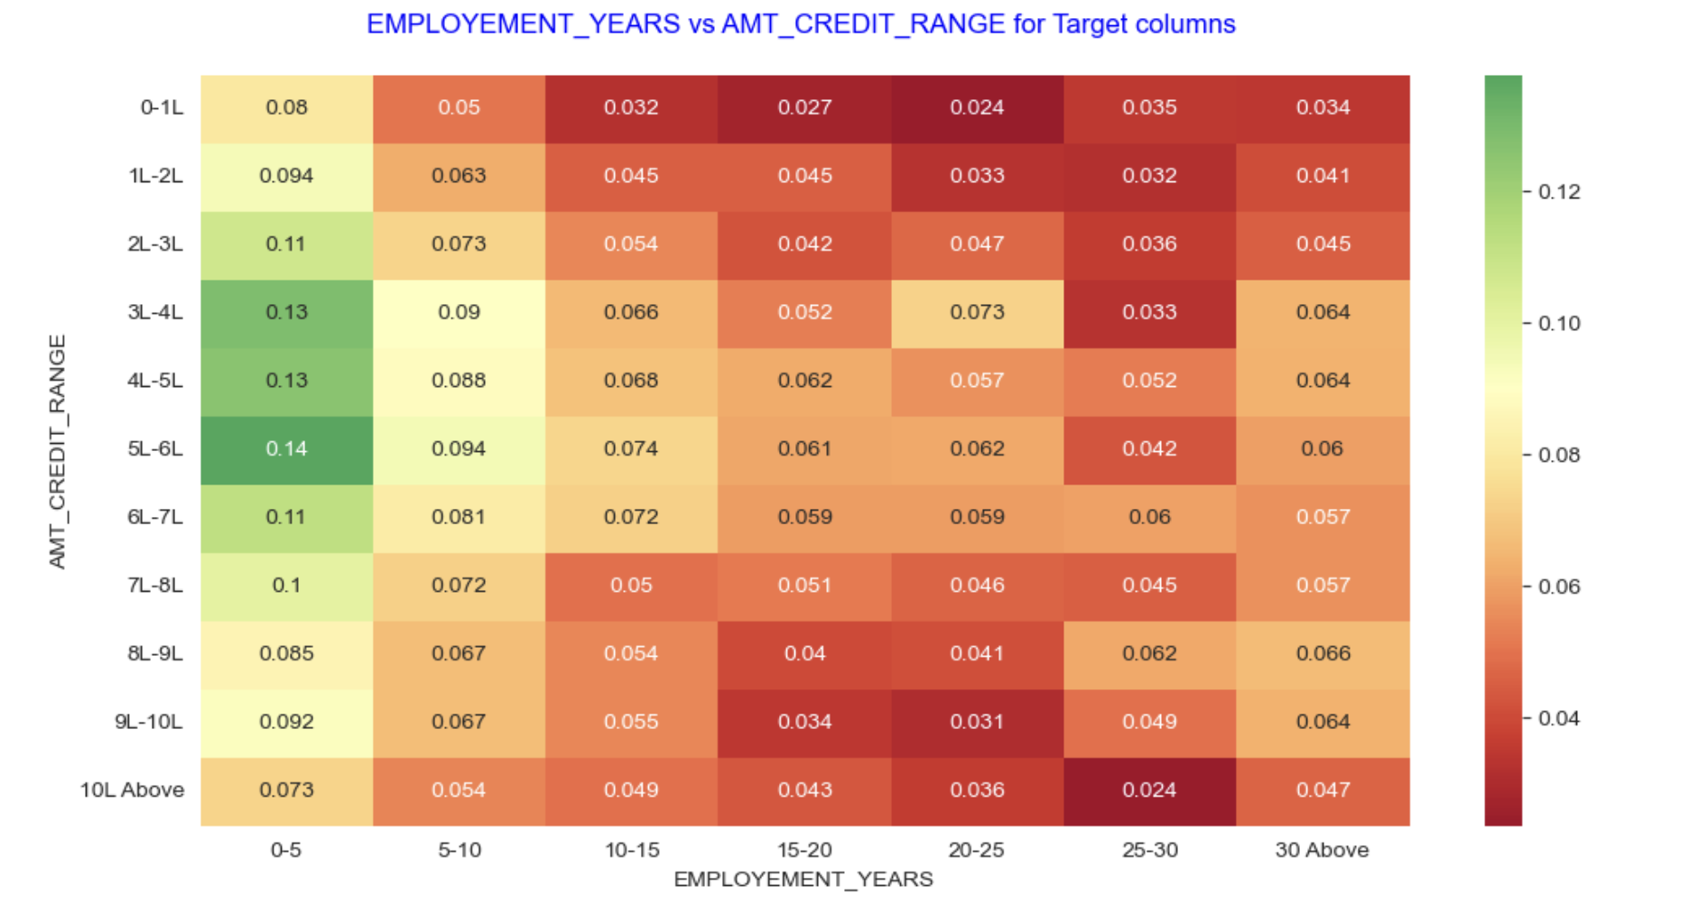
Analysis of EMPLOYEMENT_YEARS vs AMT_CREDIT_RANGE for Target columns
Employment years 0-5 have highest Amount credit for 5-6 Lakh range.
Employment years 25-30 has lowest Amount credit for 10 lakh above.

Slide 24
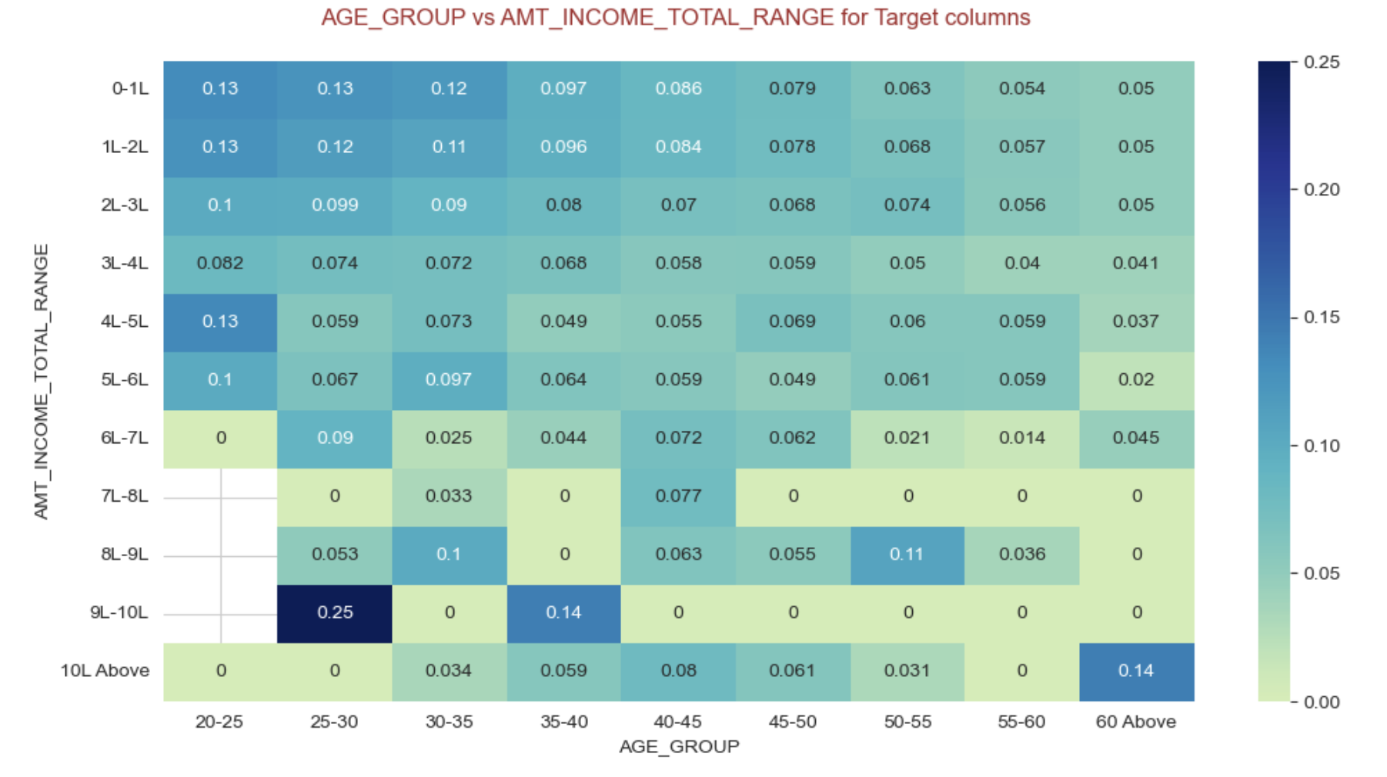
Analysis of EMPLOYEMENT_YEARS vs AMT_CREDIT_RANGE for Target columns
Age group 25-30 has highest total income.

Slide 25
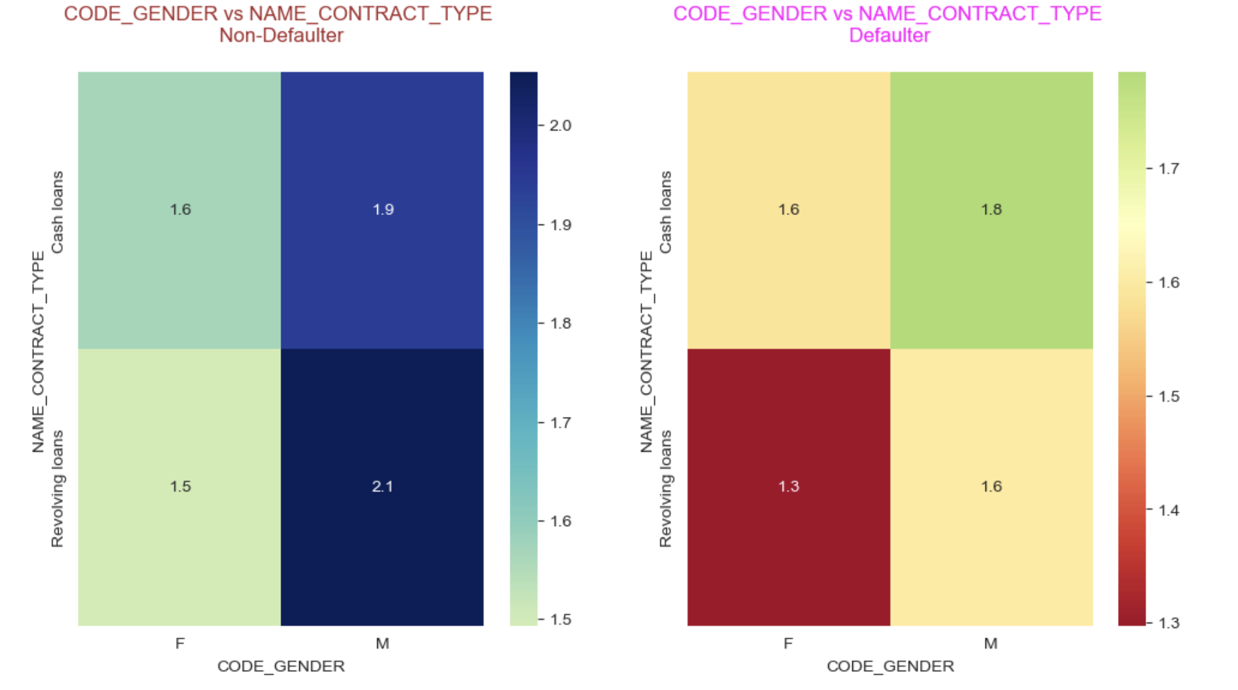
Analysis of CODE_GENDER vs NAME_CONTRACT_TYPE
Male with Revolving loans contract type has highest Non-defaulter and Female with Revolving loans contract type has lowest Non-defaulter.
Male with Cash loans contract type has highest Defaulter and Female with Revolving loans contract type has lowest defaulter.

Slide 26
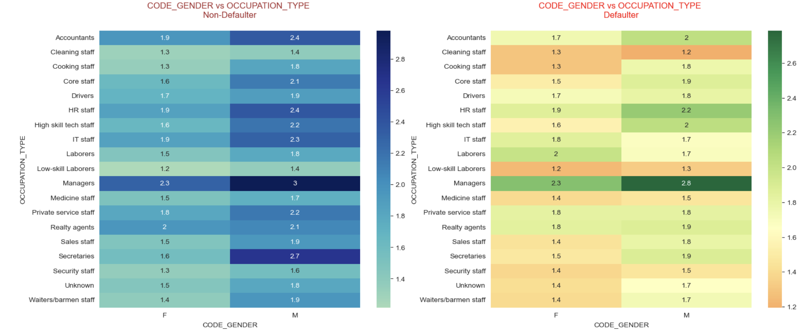
Analysis of CODE_GENDER vs OCCUPATION_TYPE
Male with Managers occupation type has highest Non-defaulter and Defaulter and Female with Low-skill laborers occupation type has lowest Non-defaulter and Defaulter.

Slide 27
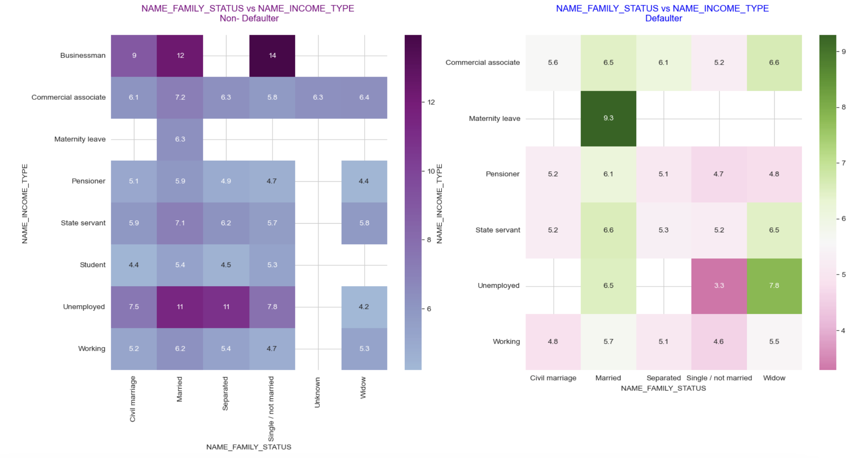
Analysis of NAME_FAMILY_STATUS vs NAME_INCOME_TYPE
Single family status with Businessman Income type has highest Non-defaulters.
Married family status with Maternity leave income type has highest Defaulters.

Slide 28
Univariate ANALYSIS ON Previous APPLICATION DATASET

Slide 29
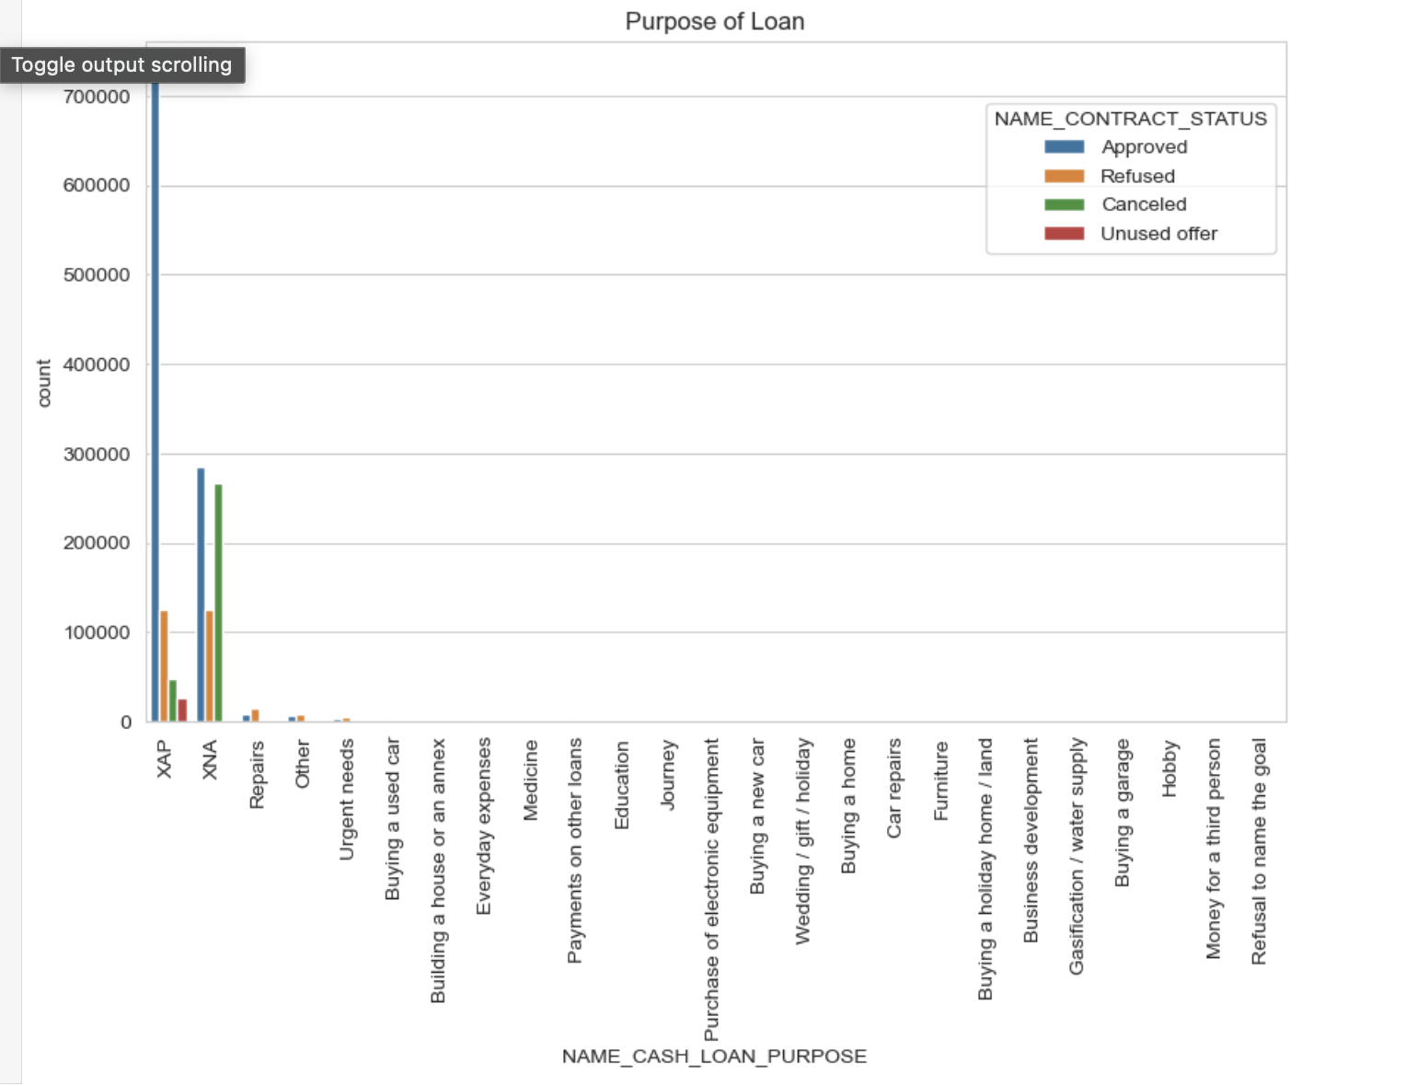
Analysis of Loan Purpose
Repairs cash loans has highest refused contract status.
For Repairs loan rejection is more than approval.
For XNA and XAP loan approval is more compared to other categories

Slide 30
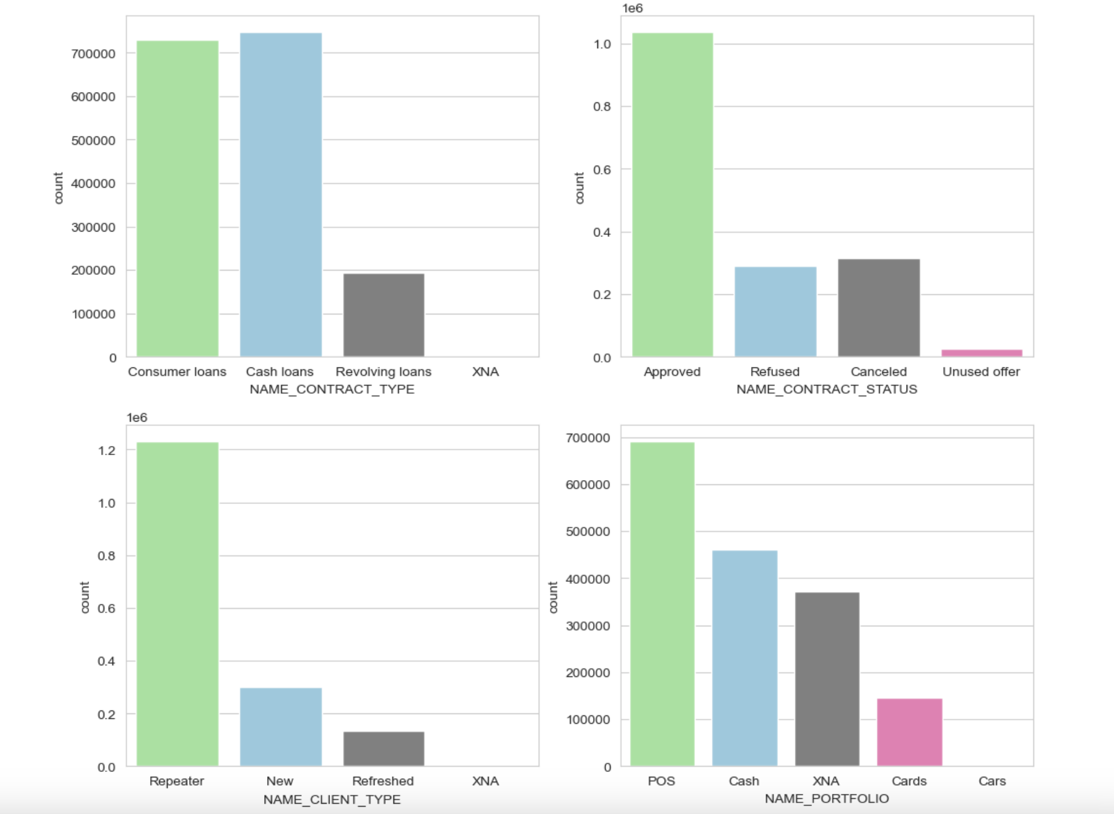
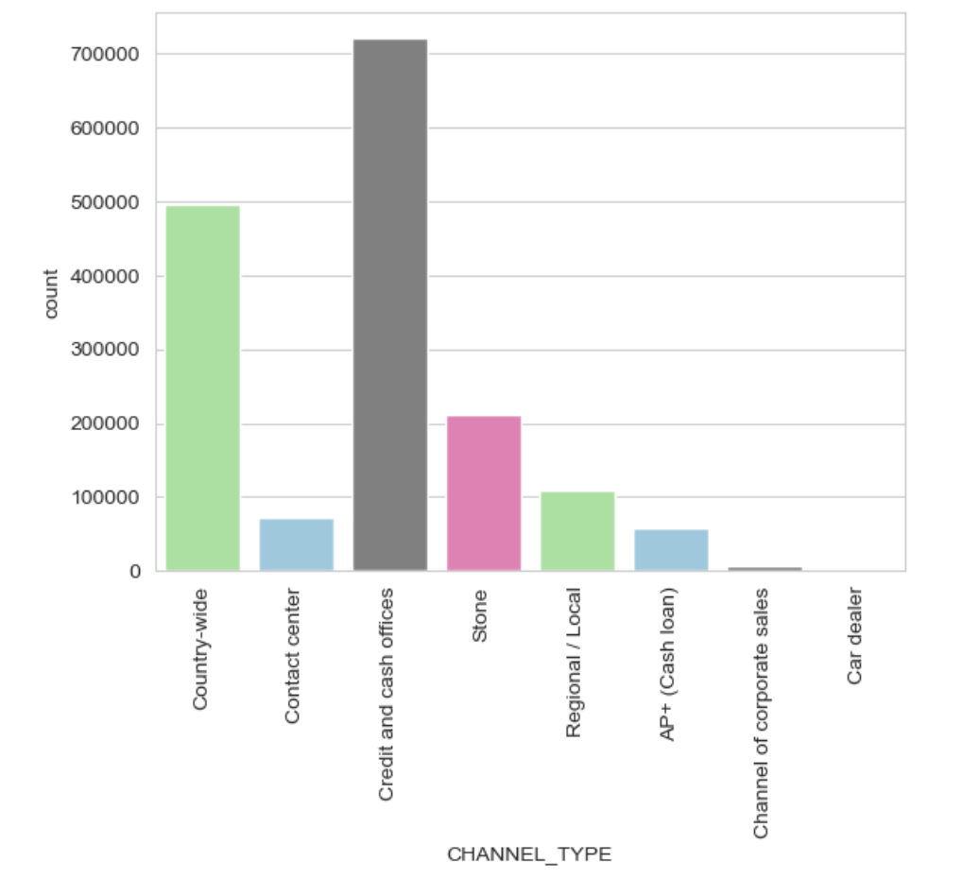
Analysis of Contract type and Status, Client and channel type, contract status
Count of Revolving loan is less compared to consumer loans and cash loans.
There are very few Refused loans. Almost negligible Canceled loans.
Number of Repeater applicants is more compared to new and refreshed applicants.
Number of application for Cards and Cars in previous application is very less and the highest number is for POS.
Credit and Cash offices channel count is more compared to other channel types.

Slide 31
Bivariate ANALYSIS ON Previous APPLICATION DATASET

Slide 32
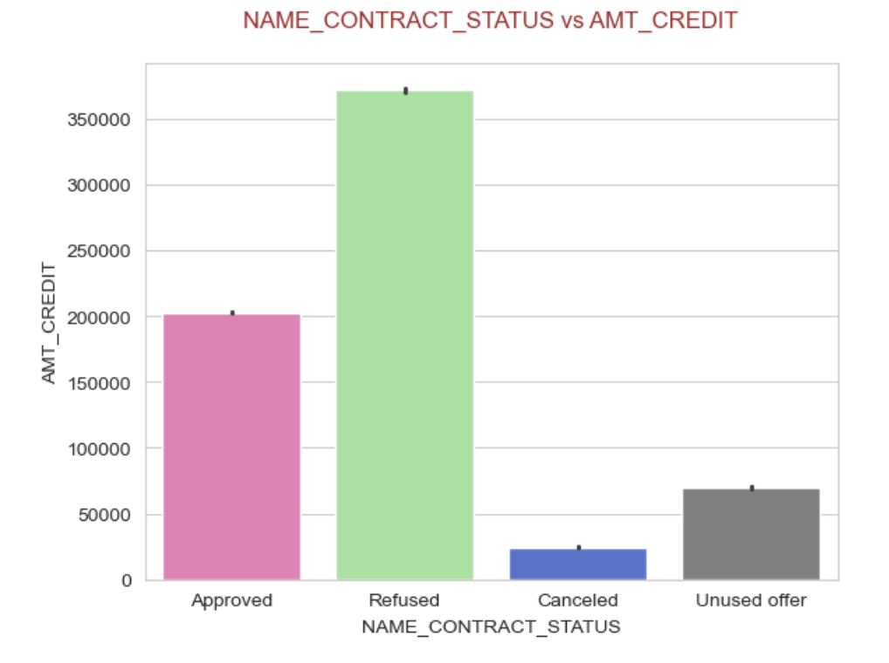
Analysis of Contract status and Amount credit
Refused Contract status has highest Amount credit.
Cancel contract status has lowest amount credit.

Slide 33
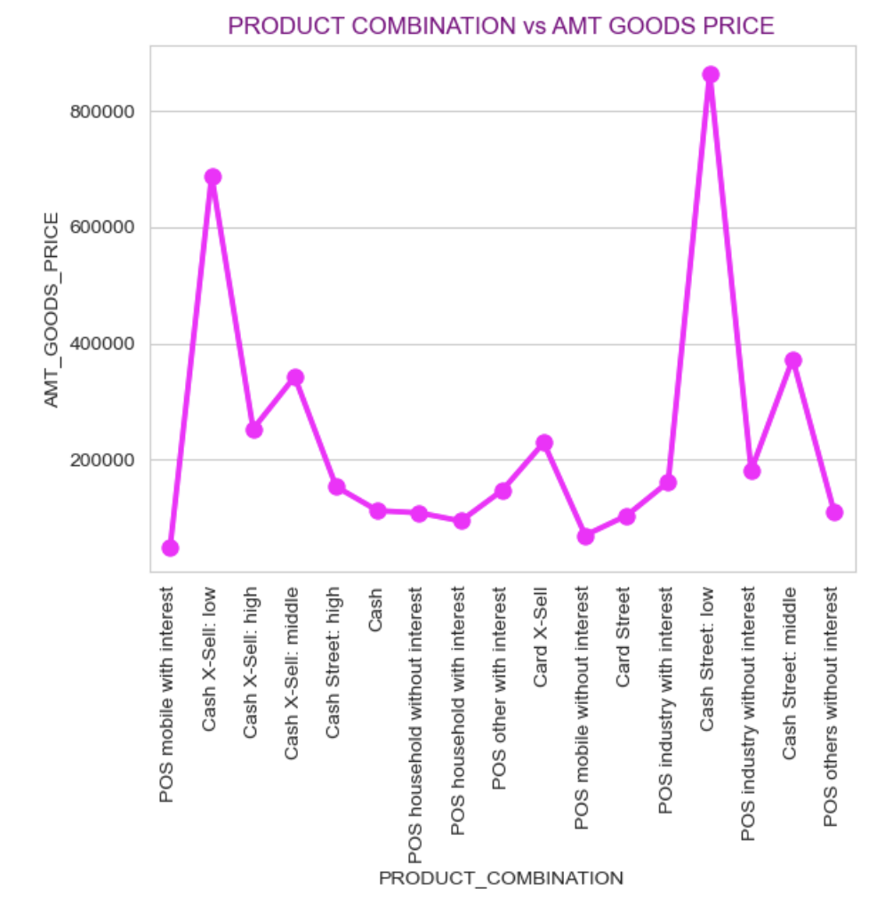
Analysis of product combination and amount goods price
Cash Street low product has highest amount goods price.
POS mobile with interest has lowest amount goods price.

Slide 34
Multi-variate ANALYSIS ON Previous APPLICATION DATASET

Slide 35
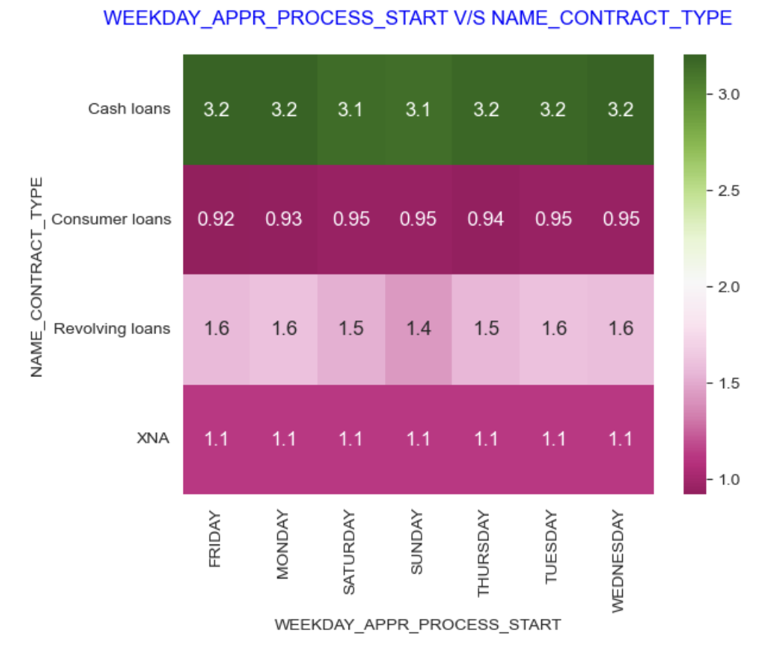
Analysis of weekday appr process start and contract type on amount goods price
Cash loans contract type has highest defaulter on Monday, Tuesday, Wednesday, Thursday, Friday.
Consumer loans contract type has lowest defaulter on Friday

Slide 36
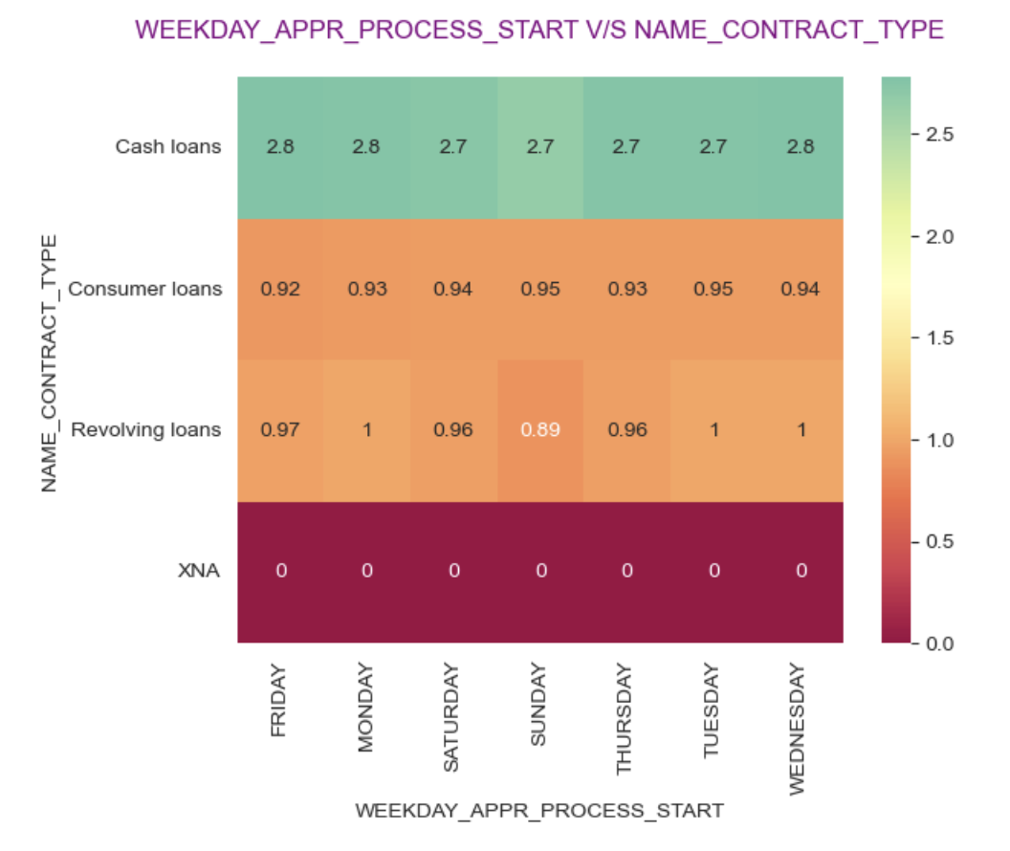
Analysis of weekday appr process start and contract type on amount application
Cash loans contract type has highest non-defaulter on Monday, Wednesday, Friday
Revolving loans contract type has lowest non-defaulter on Sunday.

Slide 37
ANALYSIS of Merged Data set ON: Current Application and Previous APPLICATION

Slide 38
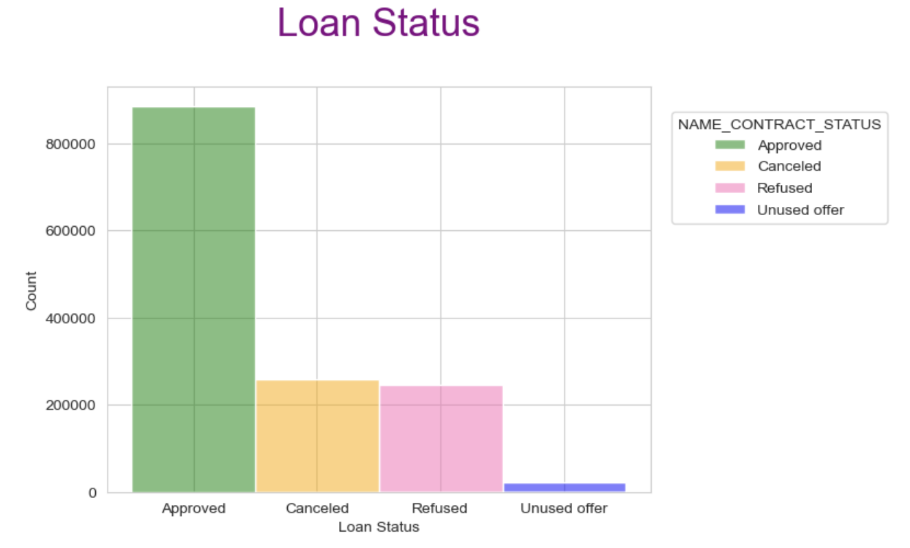
Analysis of Loan status
There are huge number of Approved loan than Refused and Canceled

Slide 39
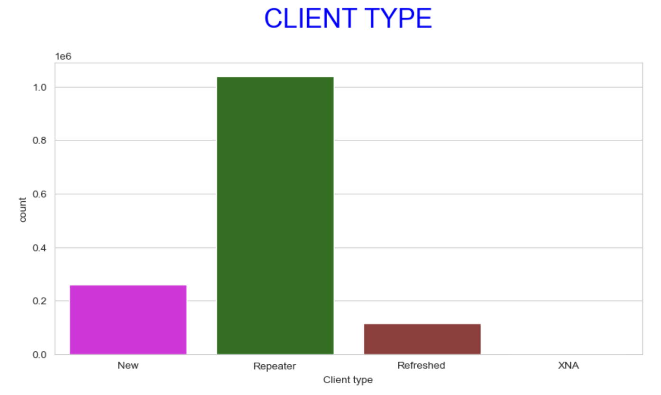
Analysis of Client type
Maximum loan applications are repeated

Slide 40
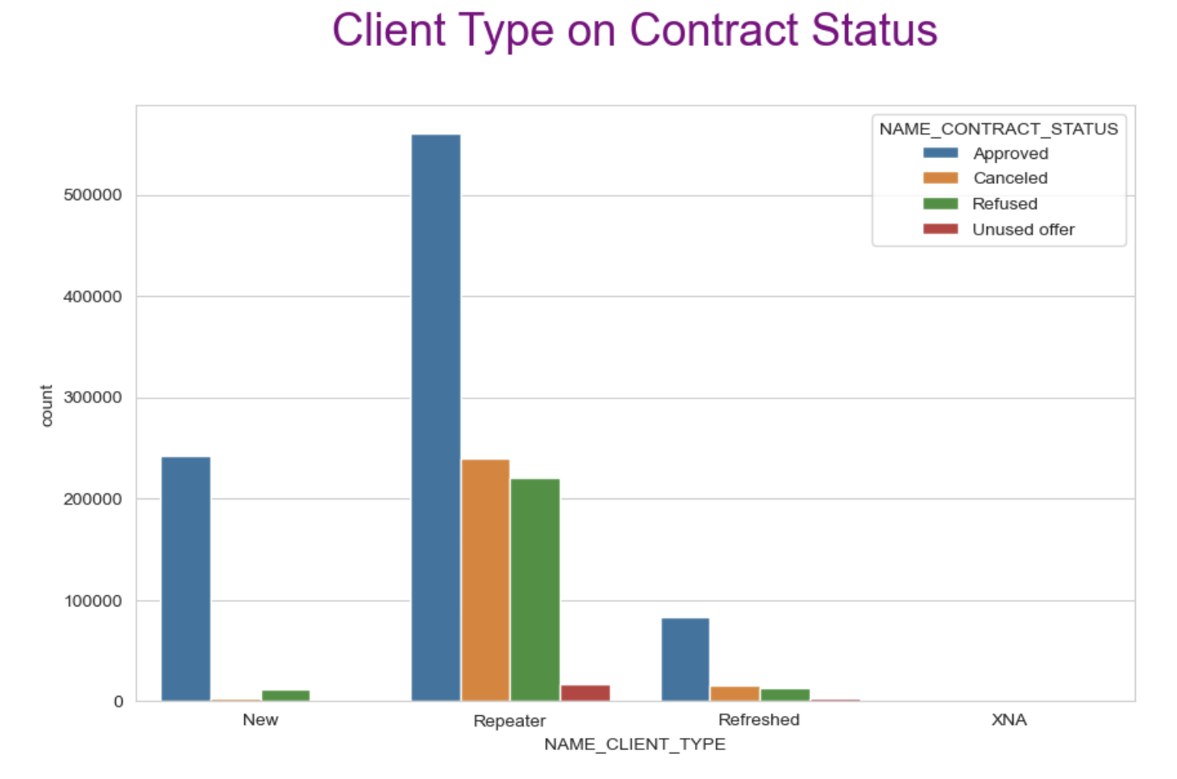
Analysis of Client type on contract status
Repeater has approved more loan in comparison to New and Refreshed

Slide 41
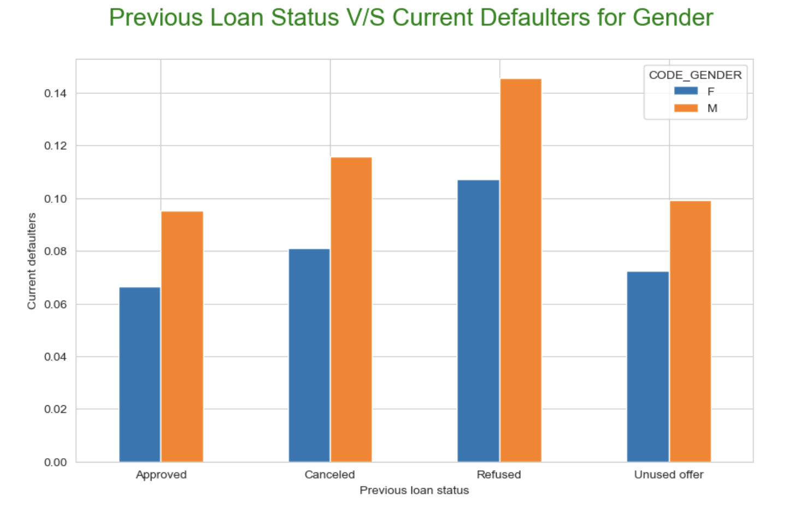
Analysis of Previous loan status and current defaulters on Gender
Previously Refused client is more defaulted than previously Approved clients.
In all the cases Males are more defaulted than Females.

Slide 42
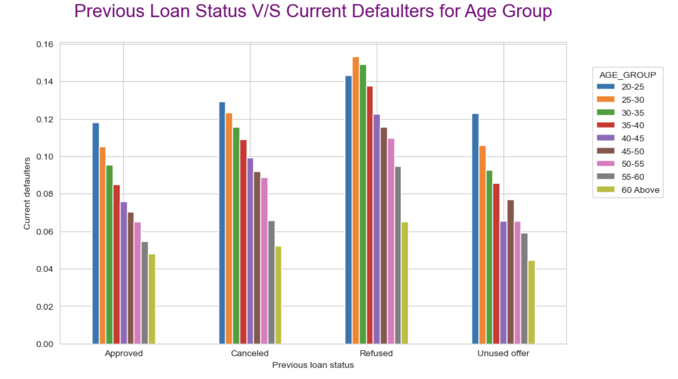
Analysis of Previous loan status and current defaulters on Age group
Age group 20-25 has more defaulter in all loan application status except refused
Age group 60 above has less defaulter in all loan application status.
Age group 25-30 has more refused defaulter

Slide 43
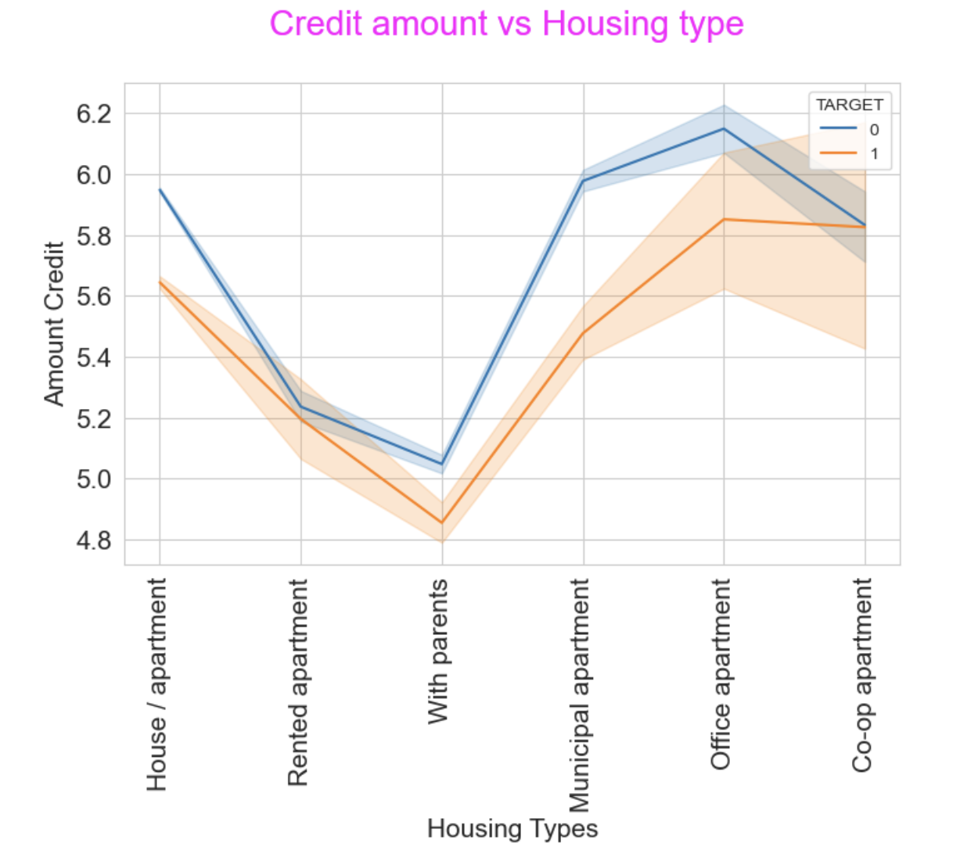
Analysis of credit amount and housing type on target
Office apartment is having higher credit of Non-Defaulter
co-op apartment is having higher credit of Defaulter
Bank should avoid giving loans to the housing type of co-op apartment as they are having difficulties in payment.

Slide 44
conclusions
Revolving Loans are having less defaulters than cash loan type.
Applicants living in own House/apartment are most likely to pay on time.
Default rate of female customers is lower than Males.
Bank can consider more experienced workers for loan as the work experience increases the default rate decreases.
Applicants with Academic degree can be considered for loan as they are less in defaulters.
Unemployed and Maternity leave segments faced difficulty in repaying the loan.
Bank should avoid giving loans to the housing type of co-op apartment as they are having difficulties in payment.

Slide 45
THANK YOU
Shekhar Anand
SHekharanand650@gmail.com

